Slide 1


NeuroNest: AI-Powered Personal Development
Tagline: Unlock Your Potential with AI.
The personal development market is worth $40 billion and growing fast.
by Collins Joshua

Slide 2

Problem: The One-Size-Fits-None Approach
Lack of Personalization
Traditional methods don't address individual needs.
Low Engagement
Generic advice results in poor motivation and outcomes.
Impact Example
80% of self-help readers fail to reach their goals.
Missed Growth
Leads to lost chances for development and career progress.

Slide 3
Solution: NeuroNest's AI-Driven Personalization
AI-Powered Plans
Focused Growth
Proven Engagement
Faster Progress
Uses algorithms to tailor development paths uniquely.
Targets strengths, weaknesses, and specific goals.
AI personalization boosts engagement by 3 times.
Users see accelerated growth and better results.

Slide 4

How NeuroNest Works: The AI Engine
1
Data Input
Gather user assessments, performance reviews, and goals.
2
AI Analysis
Leveraging NLP and predictive analytics for insights.
3
Plan Generation
Creates personalized curriculum with actionable steps.
4
Case Study
30% performance boost observed after 6 months.

Slide 5
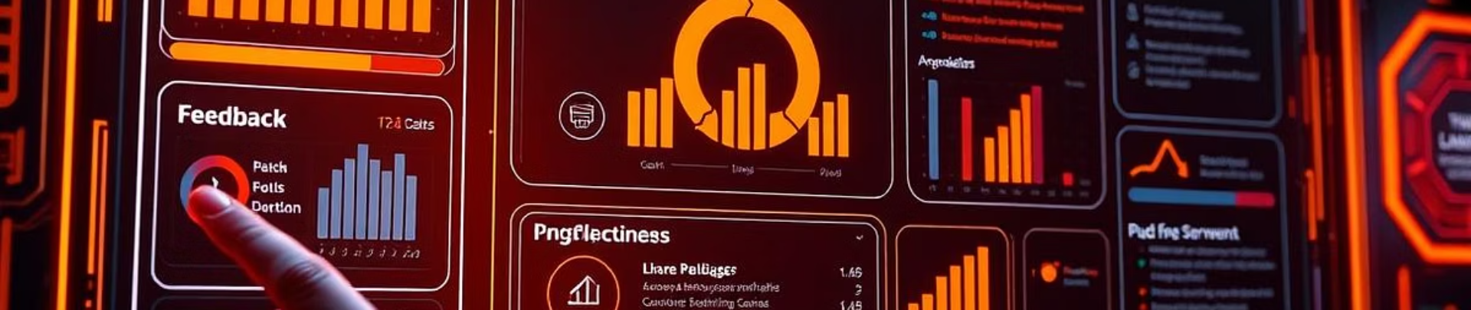




Key Features: Your AI Growth Partner
Personalized Paths
Real-Time Feedback
Skill Assessment
Seamless Integration
Identifies gaps and key areas for improvement.
Tailored learning journeys to fit individual needs.
Continuous progress tracking and adaptive guidance.
Connects with LinkedIn Learning, Coursera, and Udemy.

Slide 6




Market Opportunity: A $40B and Growing Market
Expanding Market
Target Audience
The personal development industry is rapidly growing worldwide.
1
Focused on professionals and growth-seeking organizations.
2
Future Projections
4
Rapid Growth
Market expected to reach $50B by 2025.
3
Online learning grows 20% annually.

Slide 7
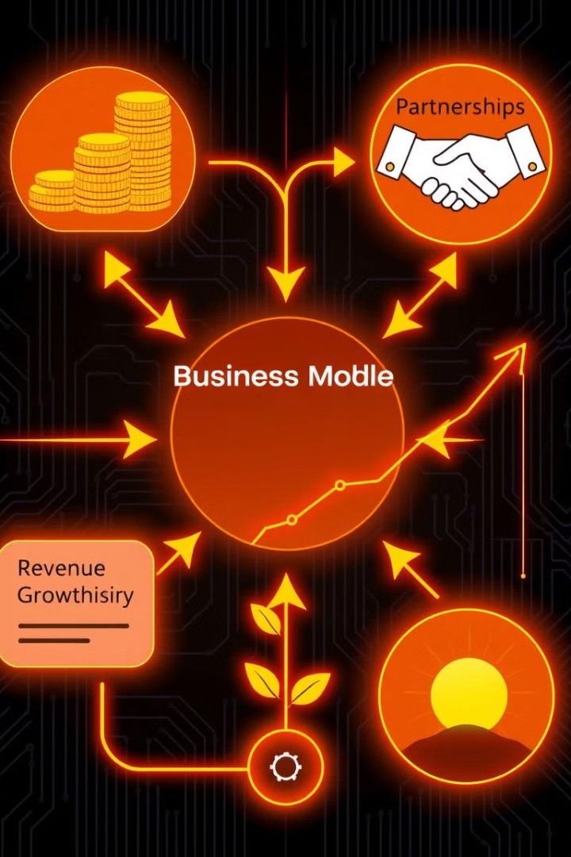




Business Model: Sustainable and Scalable Growth
Subscription Plans
Options for individuals and teams with tiered features.
Tiered Pricing
Flexible pricing aligned with support levels and features.
Partnerships
Collaborations with HR tech firms enhance reach.
Financial Goals
$5M ARR Year 1; $20M ARR by Year 3.

Slide 8

The Future: NeuroNest as a Meta-Template for Gamma AI
Meta-Template Power
Democratizing Access
Framework enables Gamma AI to create custom pitch decks.
Bringing AI-driven pitch creation to all users.
Scalable Vision
Join Us
Supports growth and adaptation across industries.
Partner in shaping the future of personal development.

